Slide 1
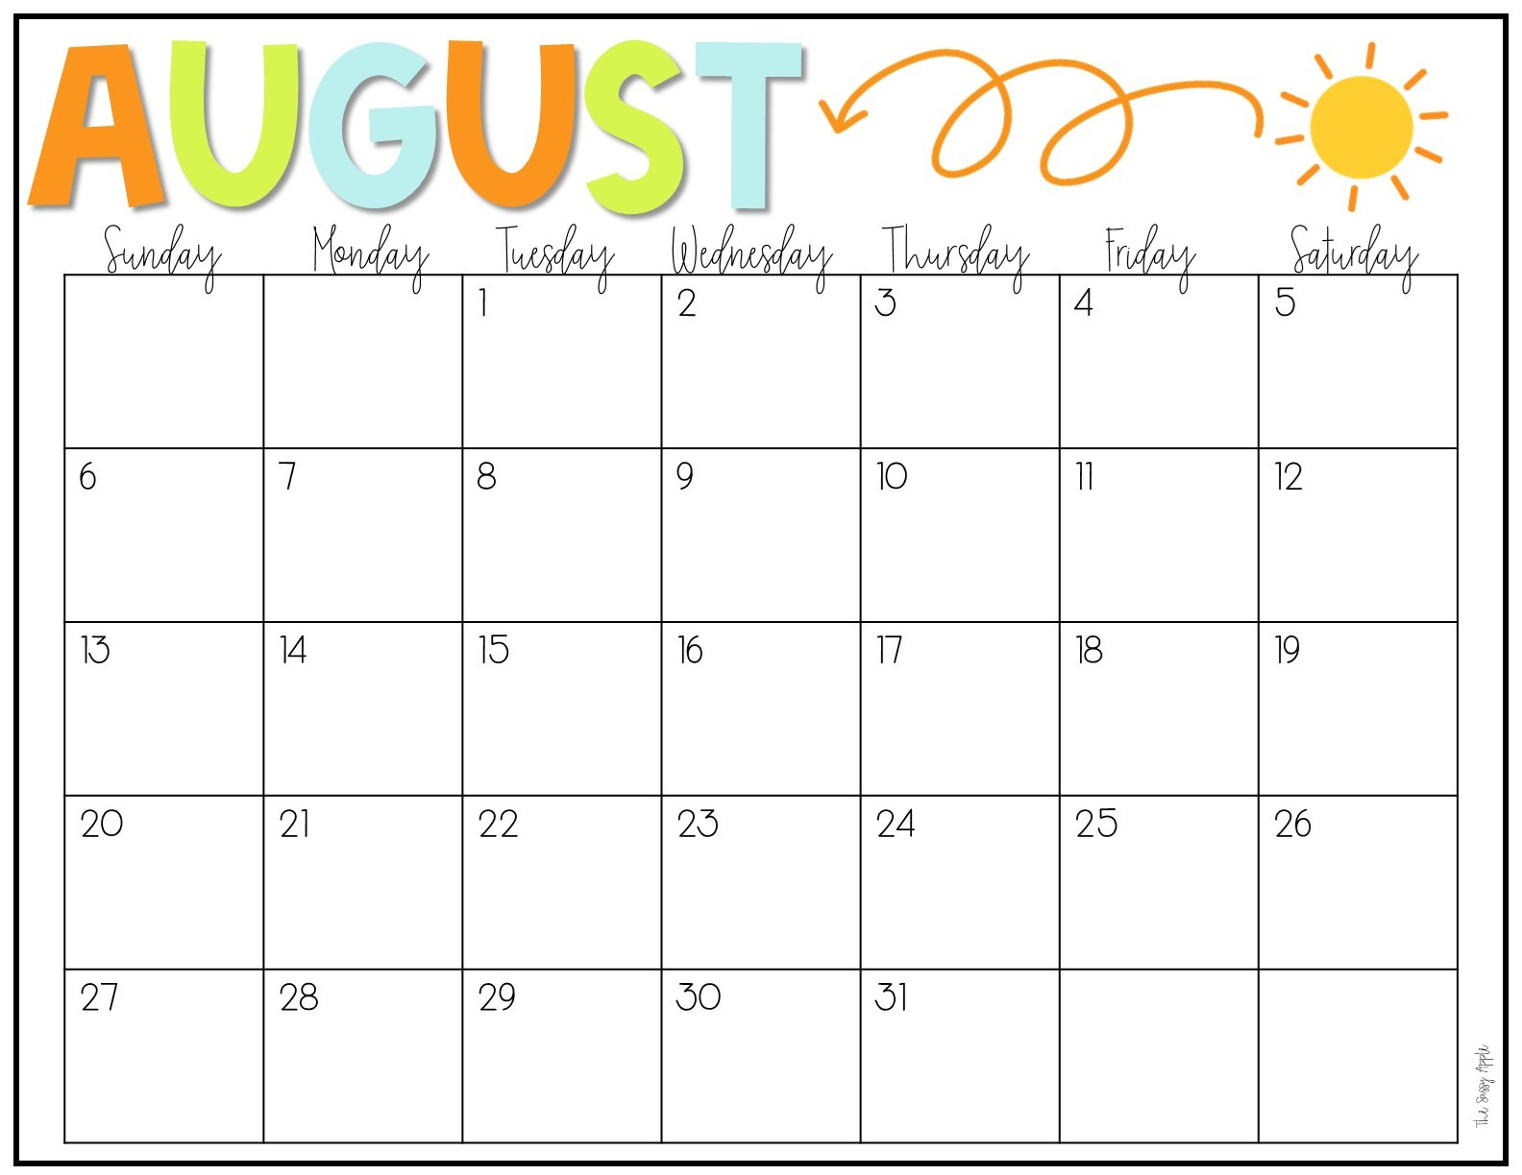
 |  | Teacher Meeting 9:00 |  |  |  | Ms. Jessica’s B’day!
 |  |  | Ms. Debra’s B’day!
Open House 3:00-5:00

Slide 2
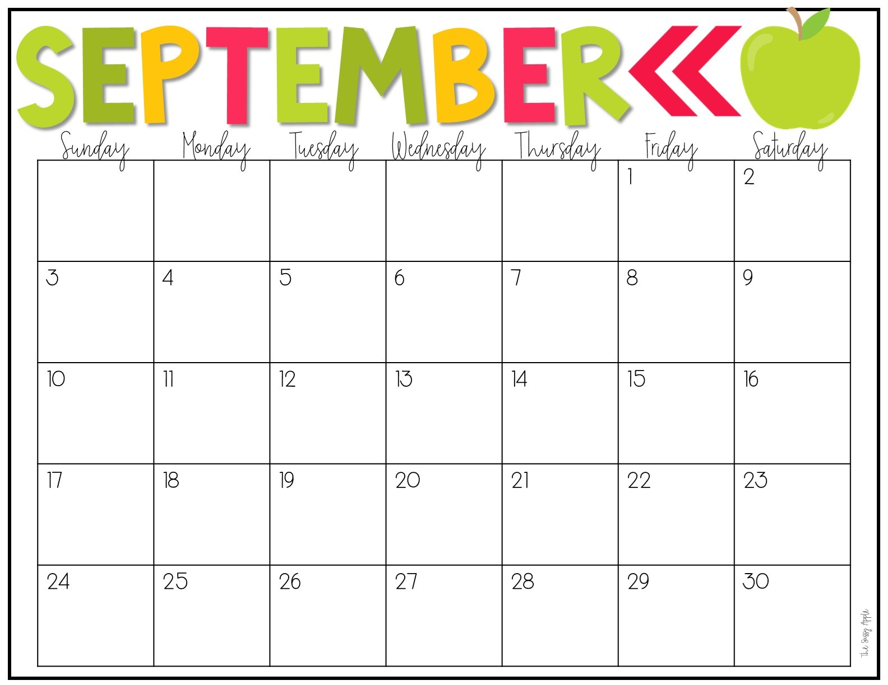
Mon/Wed 7 Tues/Thurs 8 Color: Yellow Shape: Circle | PreK Skills: name recognition and tracing/writing, numbers 1-5, scissor safety, begin cutting straight lines | Preschool Skills: Holding crayons with pincer grasp, using a glue stick, learn to unpack backpack/open lunch independently
 | Labor Day | First Day! | First Day!
Letter: A PreK: L | Ms. Tracy’s B’day! |  |  |  | Ms. Tara’s B’day!
Letter: B PreK: I Ms. Sara’s B’day!
Letter: C PreK: T
Social/Emotional:
Sitting for small periods of time, sharing/taking turns, following 2-step directions, use words to express needs & wants

Slide 3
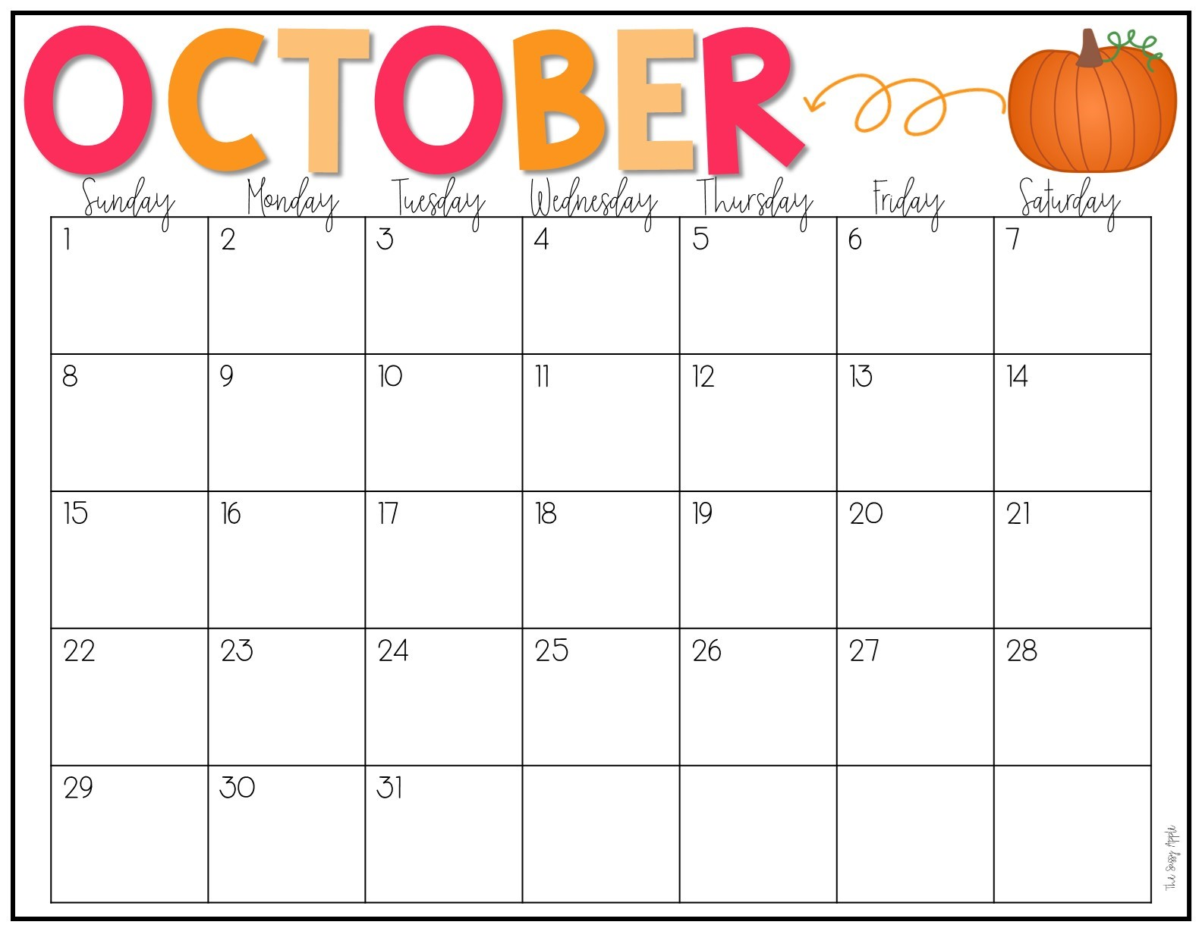
Letter: D PreK: O | (RCS Fall Break) |  |  |  | Ms. Rebecca’s B’day!
 | Fall Break | Ms. Millie’s B’day! Fall Break | Fall Break | Fall Break
Letter: E PreK: D Letter: F PreK: A Ms. AnnaAlyse’s B’day! | Book Fair Ms. Kathy’s B’day! | Book Fair | Book Fair | Book Fair
Letter: G PreK: C |  |  | Mon/Wed 7 Tues/Thurs 7 Color: Black & Orange Shape: Square | PreK Skills: name recognition and tracing/writing, numbers 1-5, scissor safety, cutting straight lines | Preschool Skills: Holding crayons with pincer grasp, using a glue stick, unpack backpack and open lunch, recognize first name | Social/Emotional: Sitting for small periods of time, sharing/taking turns, following 2-step directions, use words to express
Plant Pumpkin Seeds
Ms. Courtney’s B’day!
Plant Pumpkin Seeds
Ms. Stacey’s B’day!
Pumpkin Patch
Pumpkin Patch

Slide 4
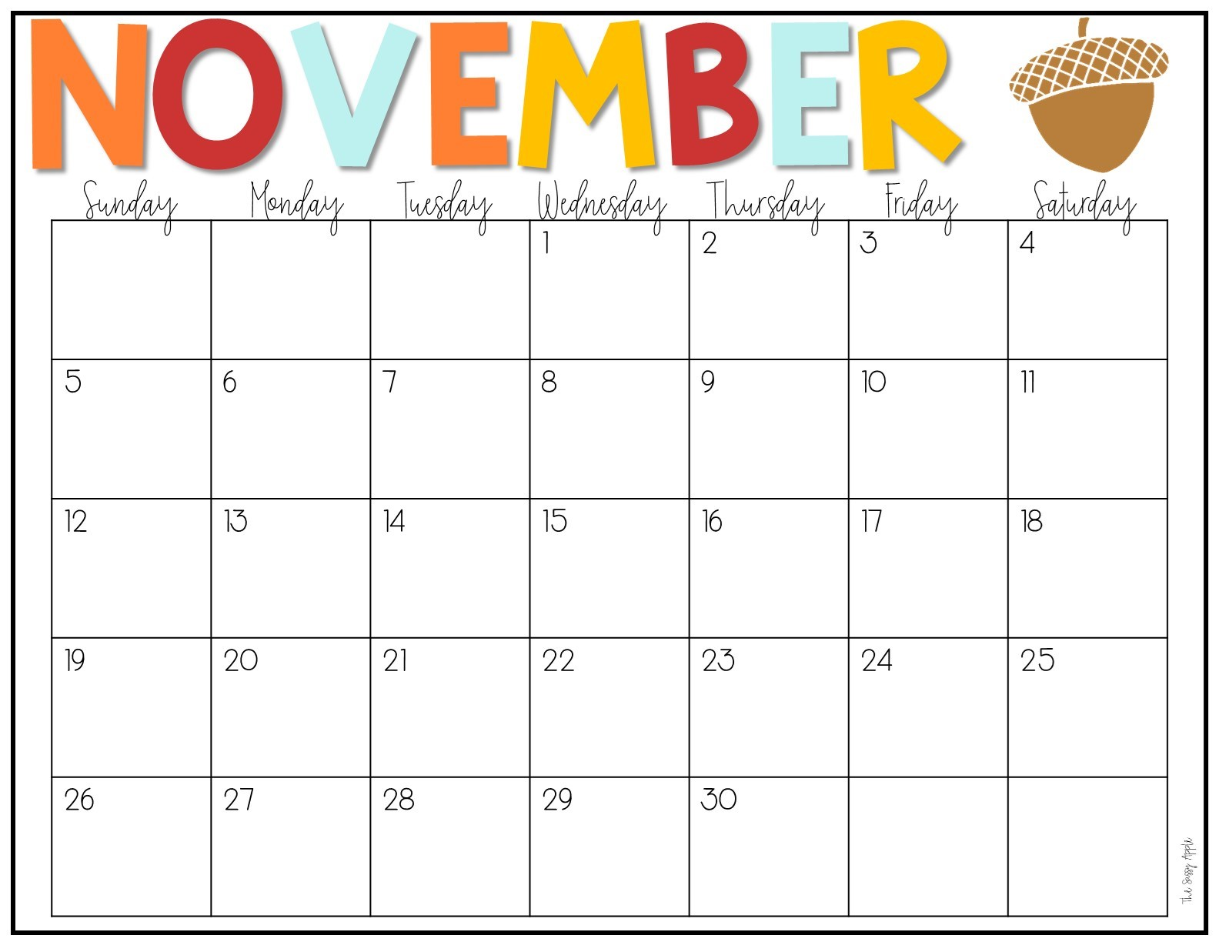
Mon/Wed 6 Tues/Thurs 7 Color: Brown Shape: Rectangle | PreK Skills: write first name, numbers 1-5, cutting straight lines | Preschool Skills: Holding crayons with pincer grasp, using a glue stick, recognize first name, independence in bathroom skills
Letter: H PreK: E | No School |  | PreK Elegant Event | PreK Elegant Event
Letter: I PreK: F |  |  | Friendsgiving | Friendsgiving
 | Thanksgiving Break | Thanksgiving Break | Thanksgiving Break | Thanksgiving Break
No Letters
Social/Emotional:
Sitting for small periods of time, sharing/taking turns, following 2-step directions, use words to express needs & wants

Slide 5
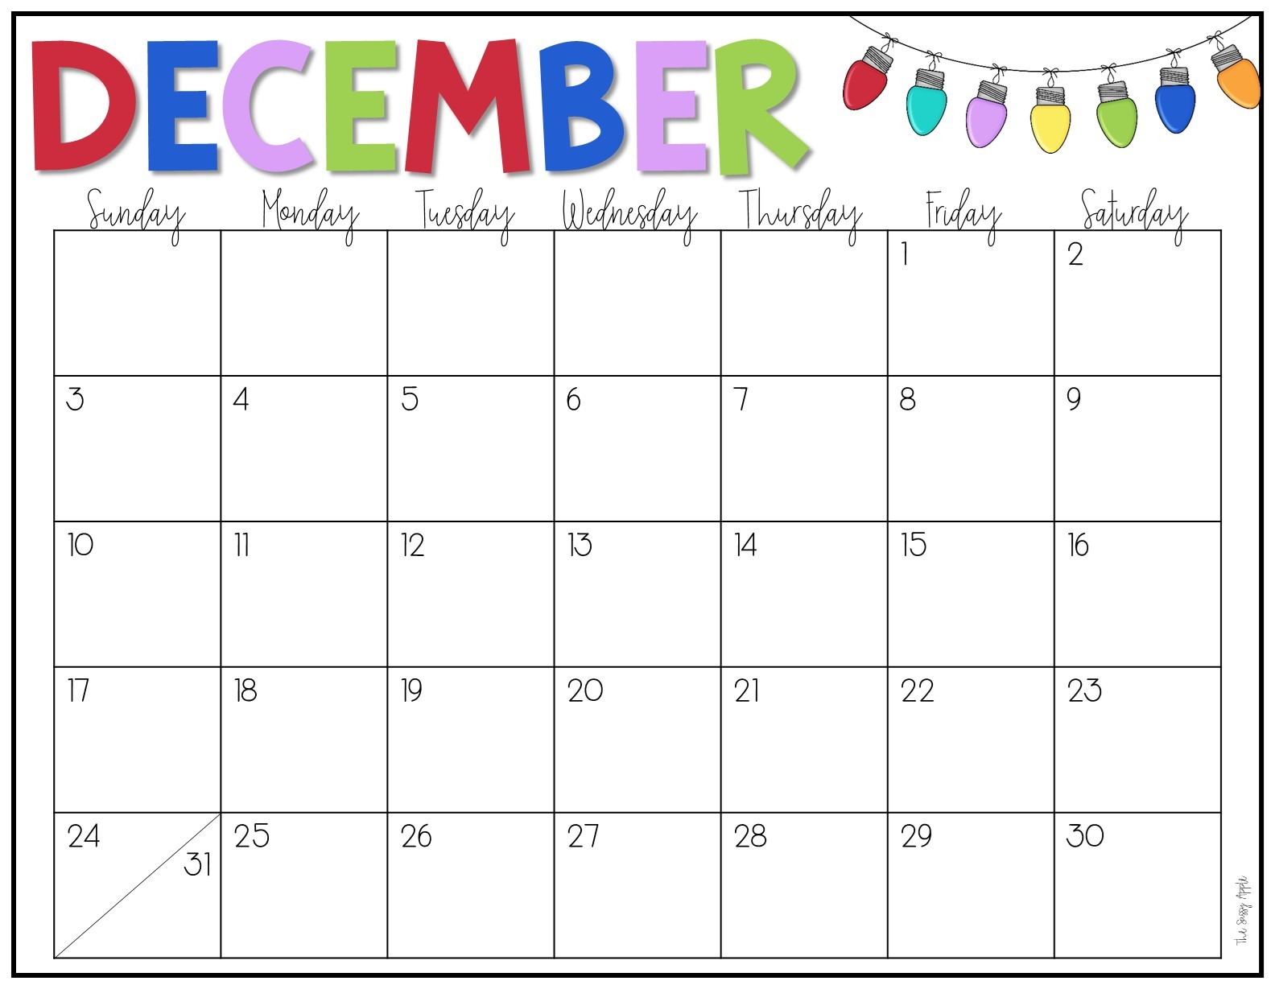
Mon/Wed 2 Tues/Thurs 2 Color: Red Shape: Triangle | PreK Skills: write first name, numbers 1-5, cutting straight lines | Preschool Skills: Holding crayons with pincer grasp, using a glue stick, independence in bathroom skills, put on coat/jacket
 | Program | Program | Cookies and Milk Last Day! | Cookies and Milk Last Day!
 | Winter Break | Winter Break | Winter Break | Winter Break! | WCS ½ Day
 | Winter Break | Winter Break | Winter Break | Winter Break |  | Ms. Tiffany’s B’day!
 | Winter Break | Winter Break | Winter Break | Winter Break | Ms. Brittany’s B’day!
Social/Emotional:
Sitting for small periods of time, sharing/taking turns, following 2-step directions, use words to express needs & wants

Slide 6
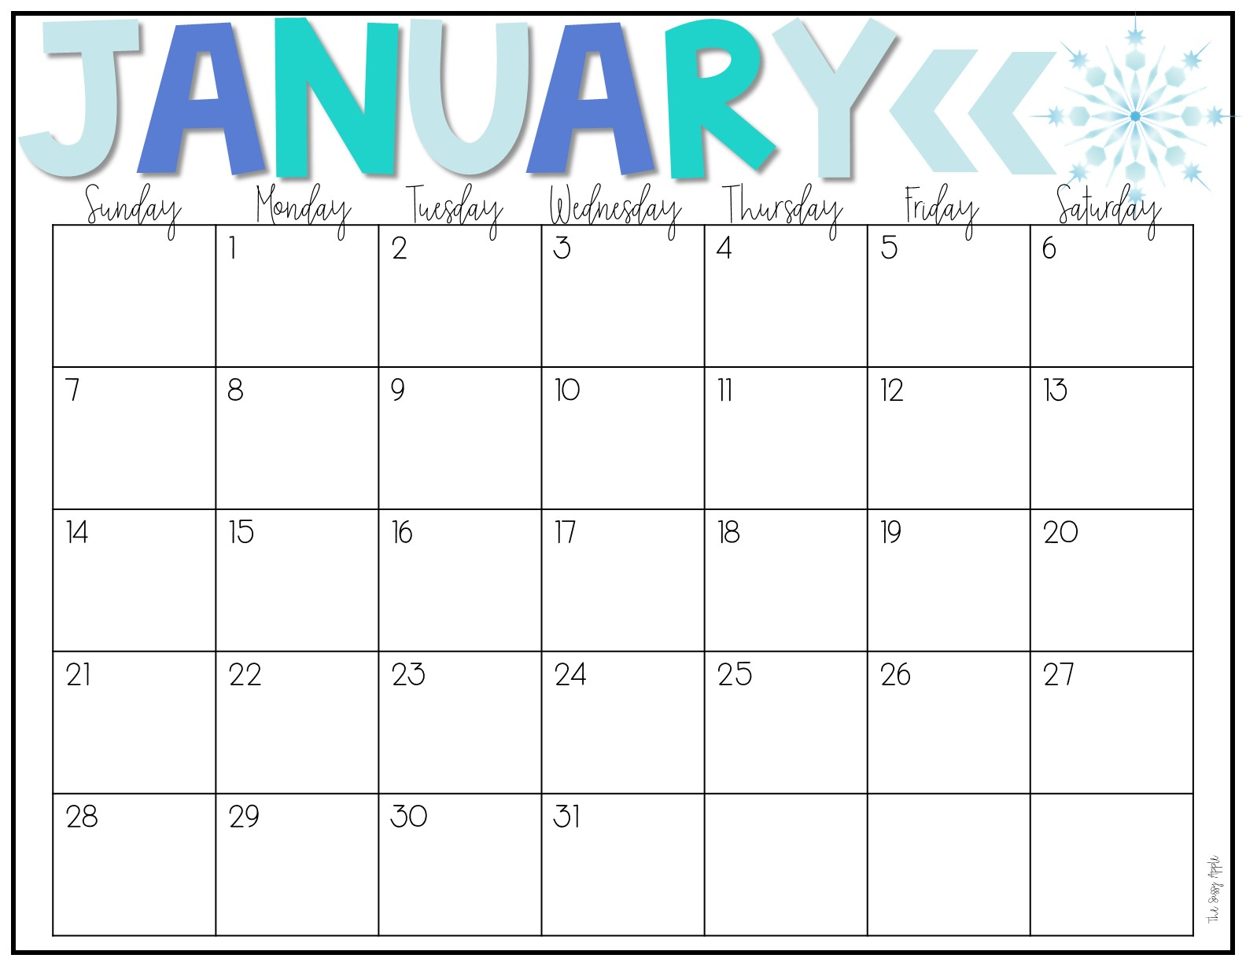
Mon/Wed 8 Tues/Thurs 8 Color: White Shape: Oval |  |  | First Day Back !
Letter: J PreK: G
Letter: K PreK: J | CLOSED MLK Day!
Letter: L PreK: U
Letter: M PreK: B |  |  | PJ Day and Hibernation! | PreK Skills: write first name, numbers 6-10, cutting straight/curve lines | Preschool Skills: Begin using correct pencil grip, begin using scissors, put on coat/jacket, sort by size/color | Social/Emotional: Sitting for small periods of time, sharing/taking turns, following 2-step directions, use words to express

Slide 7
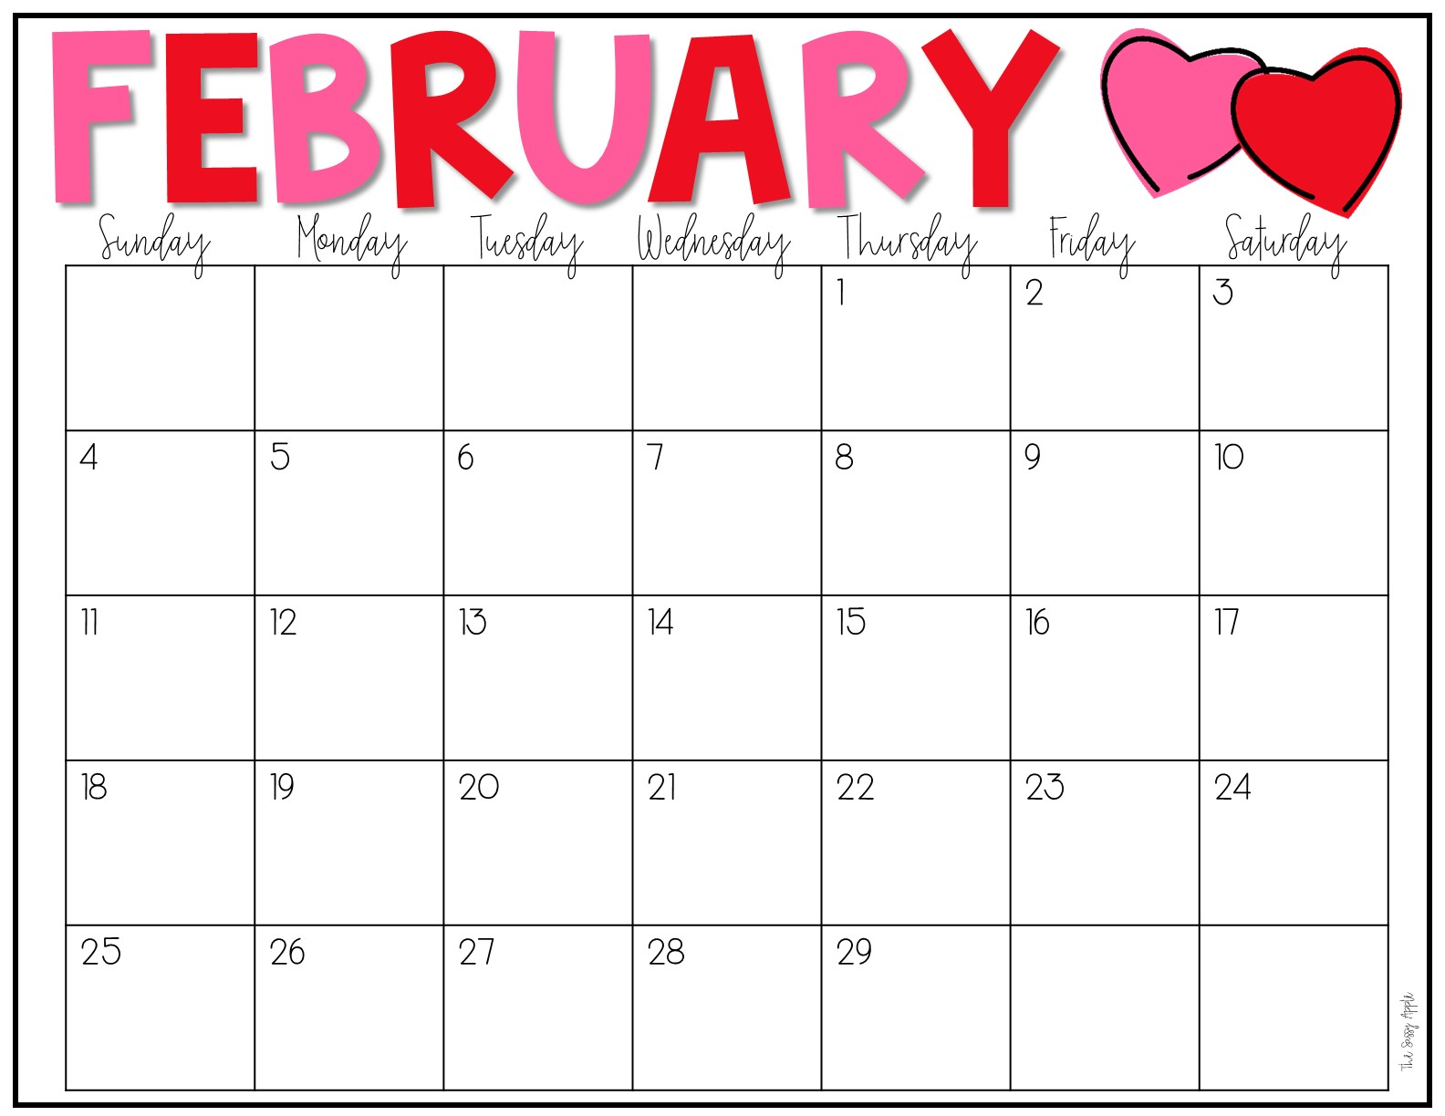
Mon/Wed 7 Tues/Thurs 9 Color: Pink Shape: Heart | PreK Skills: write first name, recognize last name, numbers 6-10, cutting straight/curve lines | Preschool Skills: Begin using correct pencil grip, begin using scissors, sort by size/color | Social/Emotional: Sitting for small periods of time, sharing/taking turns, following 2-step directions, use words to express | PJ Day and Hibernation!
Letter: N PreK: M | Hat Day | Crazy Sock Day Ms. Amy S’s B’day! | Wacky Tacky | Read My Shirt
Letter: O PreK: N Letter: P PreK: P
Letter: Q PreK: S |  | Ms. Amy P’s B’day!
Valentine’s Party!
Valentine’s Party!
Pirates and Princess Day!
Pirates and Princess Day!
CLOSED

Slide 8
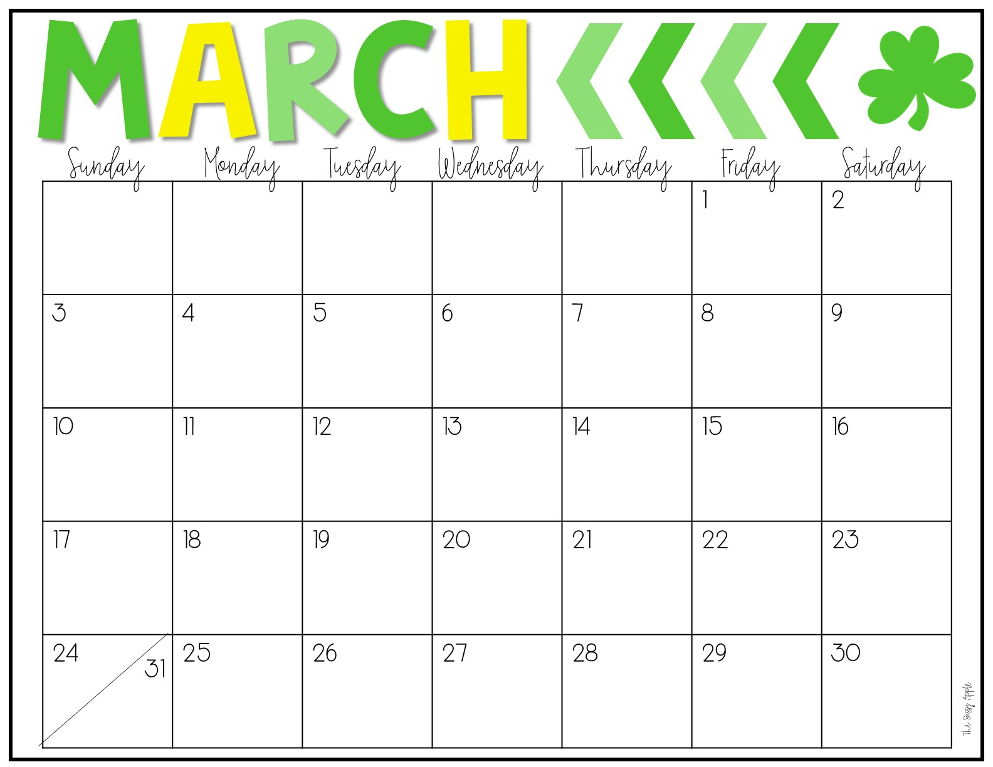
Mon/Wed: 6 Tues/Thurs: 6 Color: Green Shape: Diamond | PreK Skills: write first name, recognize last name, numbers 6-10, cutting simple shapes | Preschool Skills: Using correct pencil grip, Using scissors, count to 10-20
Letter: R PreK: R Letter: S PreK: K | Ms. Bethany’s B’day! CLOSED | FOR | Rodeo Day! SPRING Easter Egg Hunt! | Rodeo Day! BREAK! Easter Egg Hunt!
 | (RCS Spring Break)
Social/Emotional:
Sitting for small periods of time, sharing/taking turns, following 2-step directions, use words to express needs & wants

Slide 9
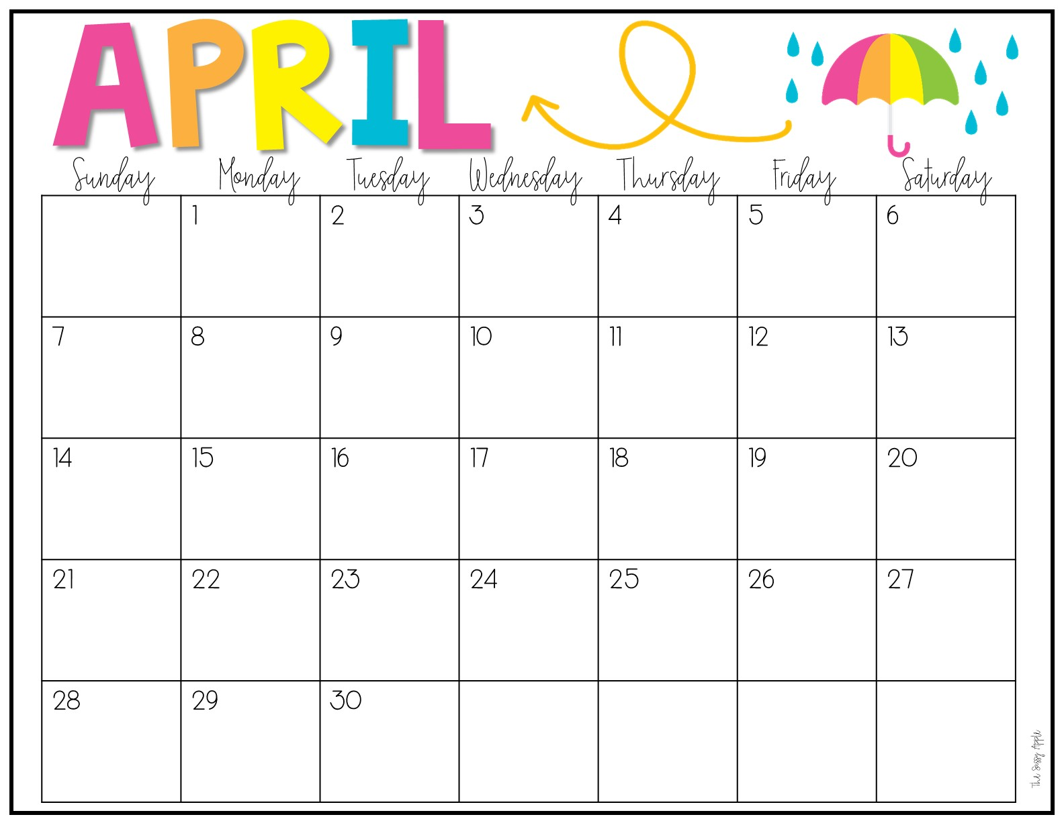
Letter: U PreK: Q Letter: V PreK: H Ms. Beth’s B’day! Letter: W/X PreK: W/X Letter: Y/Z PreK: Y/X | Ms. Marti’s B’day! | Ms. Blair’s B’day!
Mon/Wed: 9
Tues/Thurs: 9
Color: Purple
Shape: Star
PreK Skills: write first name, recognize/write last name, numbers 6-10, cutting simple shapes
Preschool Skills:
Using correct pencil grip, Using scissors, count to 10-20
Social/Emotional:
Sitting for small periods of time, sharing/taking turns, following 2-step directions, use words to express

Slide 10
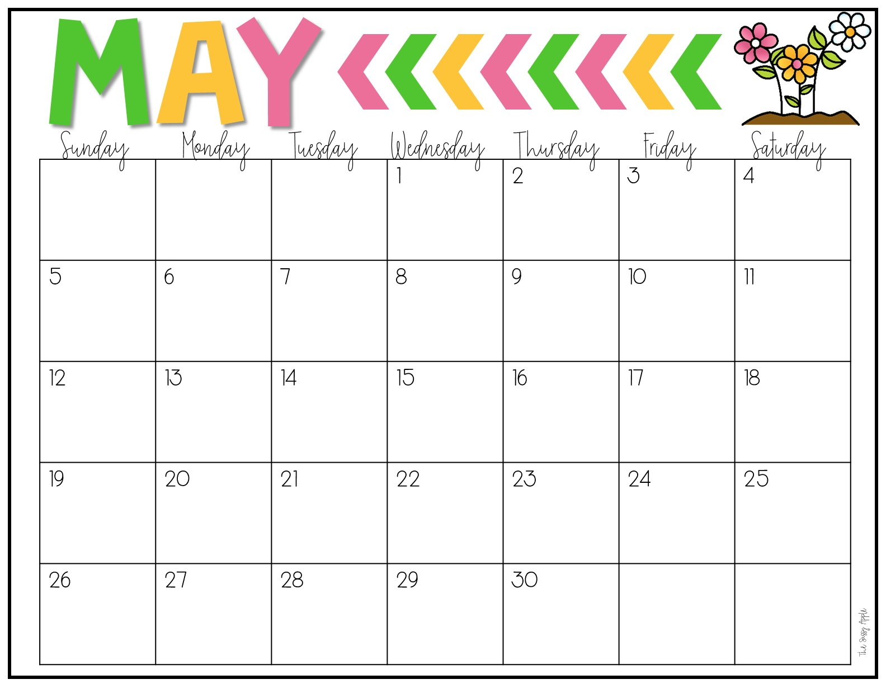
Mon/Wed 3 Tues/Thurs 3 Color: Blue Shape: Review | PreK Skills: write first name, write last name, numbers 6-10, cutting simple shapes | Preschool Skills: Using correct pencil grip, using scissors, count to 10-20
 | End of Year Program and PreK Graduation! | End of Year Program and PreK Graduation! | Last Day! | Last Day!
 | Ms. Debbie’s B’day! |  | Ms. Erin’s B’day!
 |  |  |  |  | 31 | Social/Emotional: Sitting for small periods of time, sharing/taking turns, following 2-step directions, use words to express

Slide 11
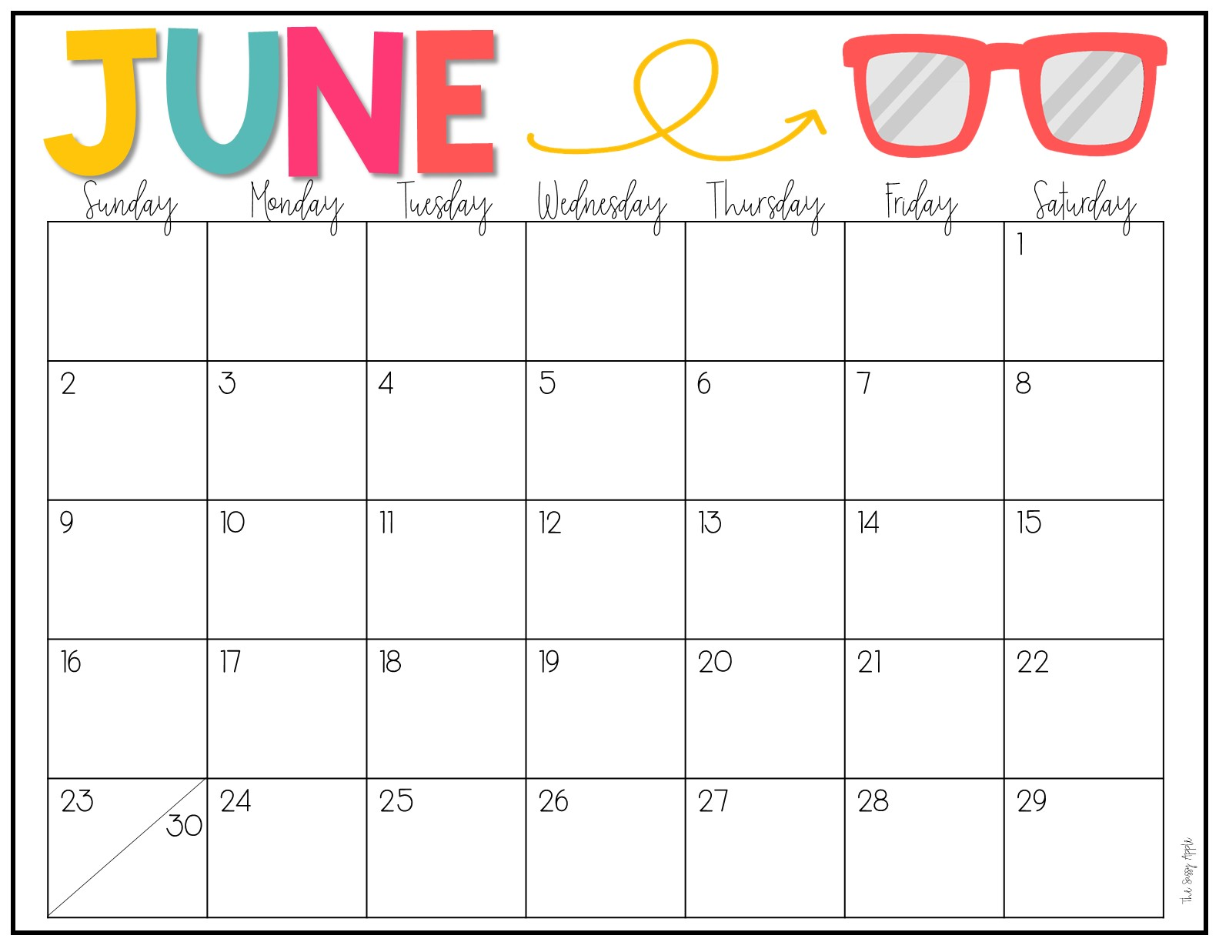
 |  | First Day Summer Program
 |  |  |  |  |  | Ms. Jill’s B’day!
 |  |  |  |  |  | Ms. Cayci’s B’day!

Slide 12
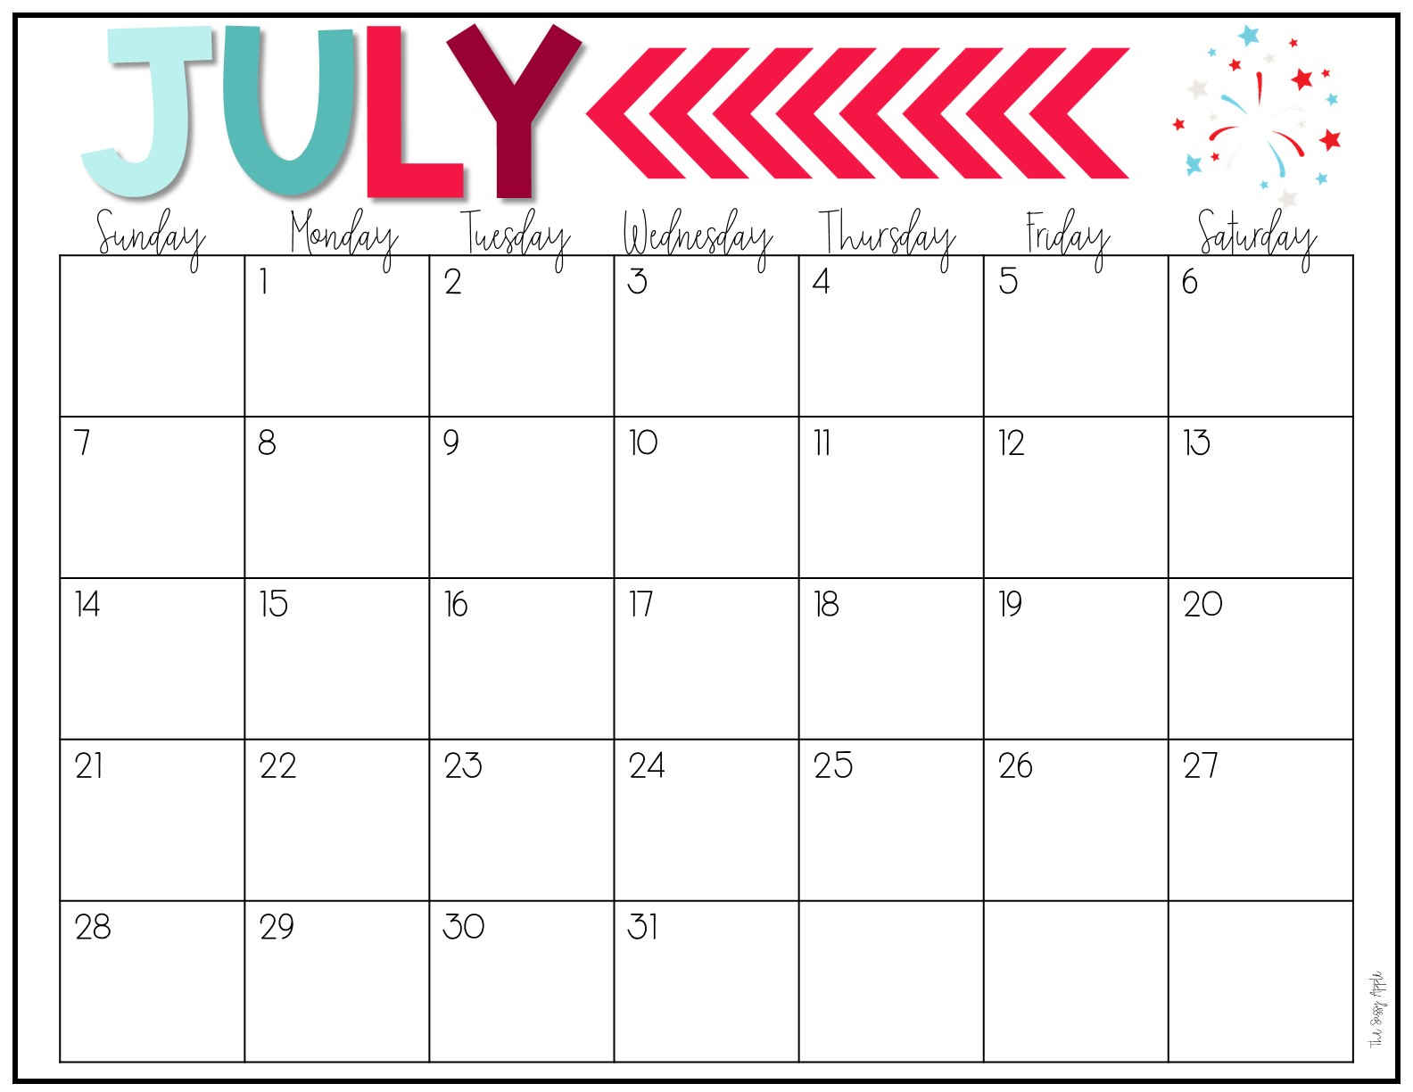
 |  | CLOSED | CLOSED | CLOSED
 |  | Ms. Sandy’s B’day!
 |  |  |  | LAST DAY! Ms. Heather’s B’day!

