Slide 1
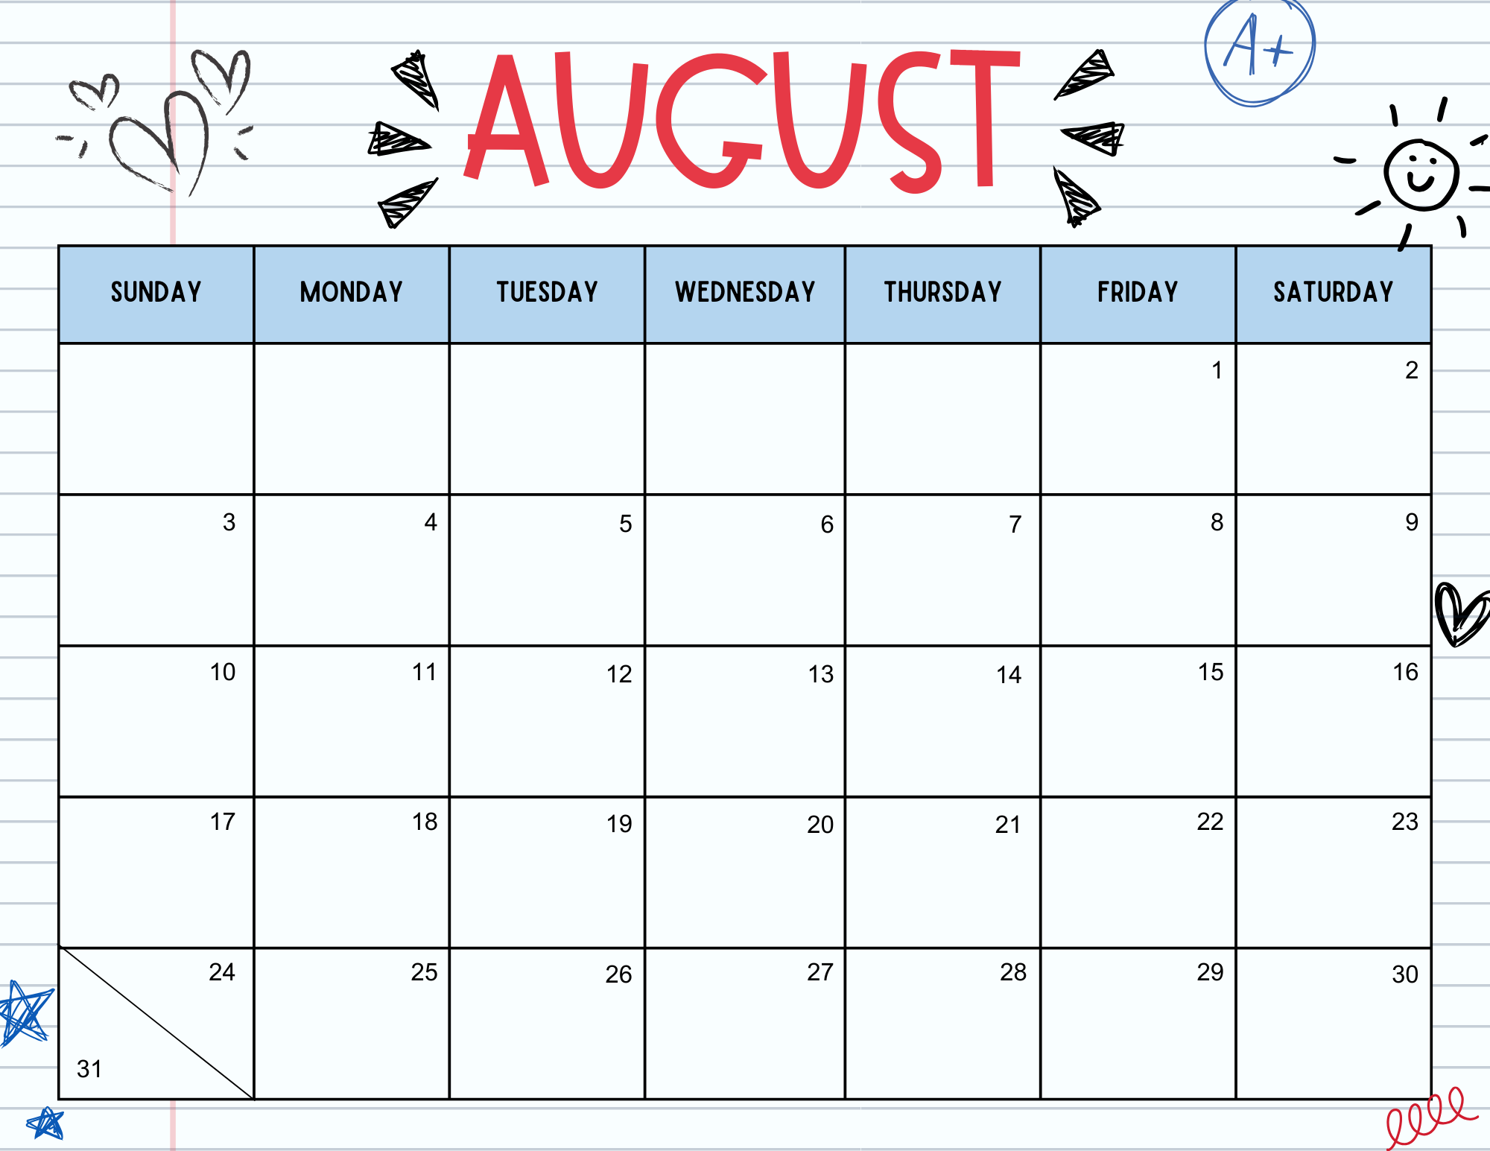

M/W: 59 T/Th: 62
Ms. Sarah’s B’day!
Open House

Slide 2
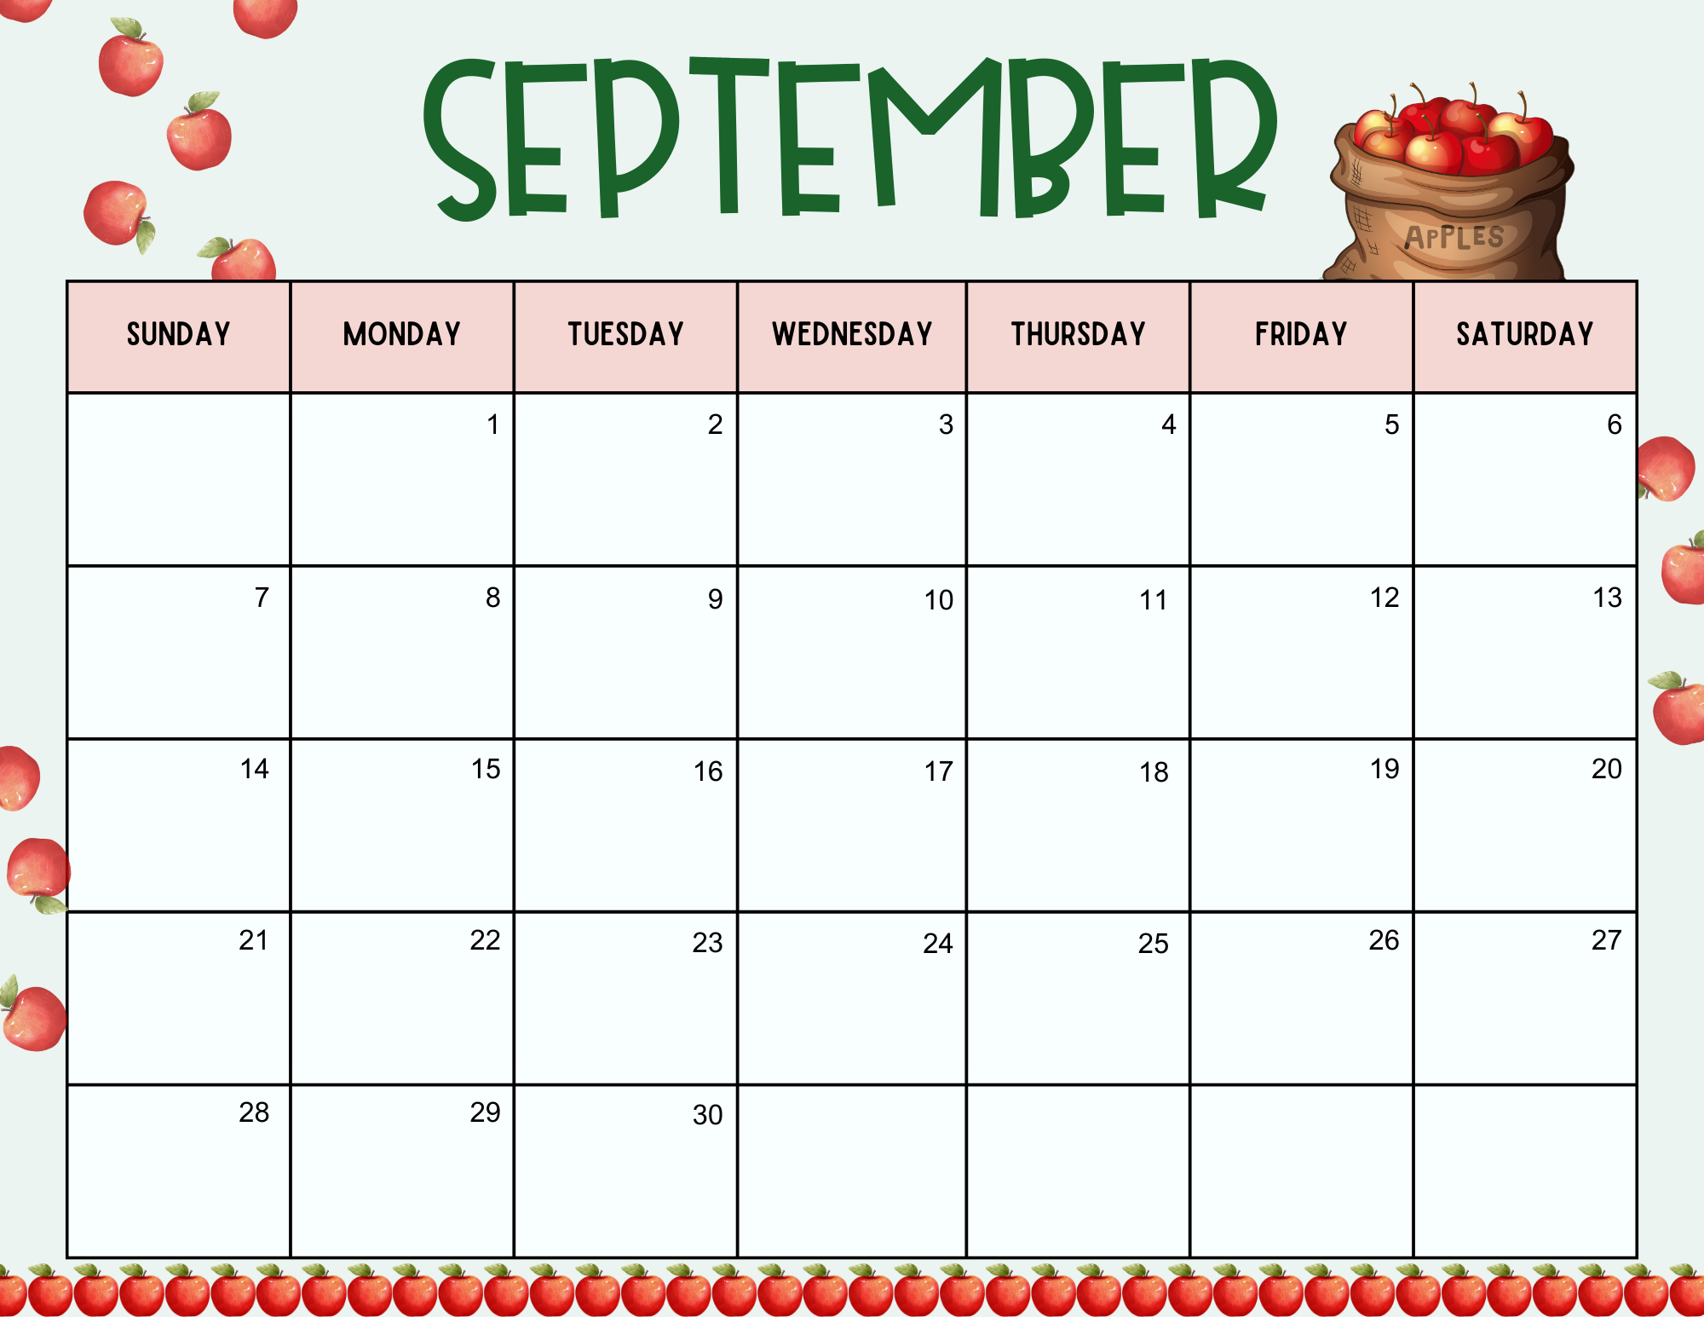

M/W: 8 T/Th: 9 Yellow Circle |  | JDS 1st Day | JDS 1st Day
A PreK: L |  |  | Lions Club Eye Exams | Ms. Tracy’s Birthday Lions Club Eye Exams
B PreK: I | Ms. Tara’s B’day! Ms. Amber’s B’day! |  | Ms. Sara’s Birthday WCS Early Release
C PreK: T
D PreK: O

Slide 3
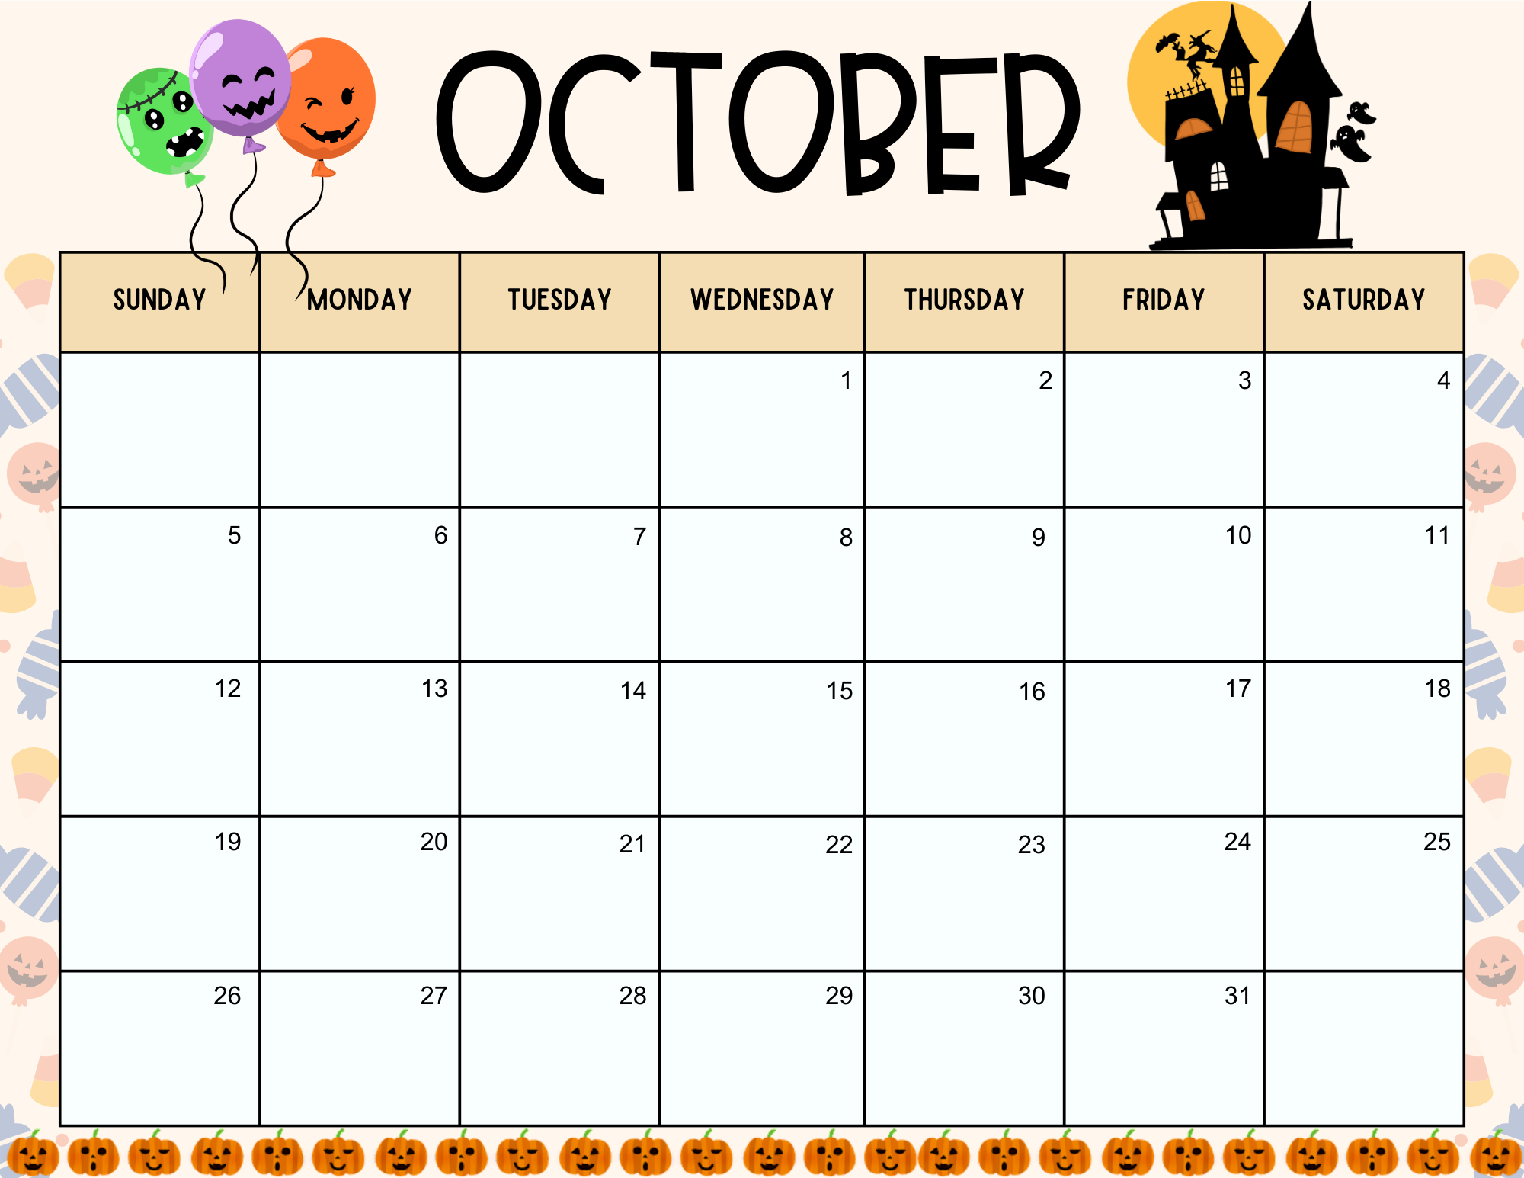

M/W: 7 T/Th: 7 Black & Orange Square |  |  | WCS Early Release
E PreK: D
F PreK: A | Pumpkin Seeds | Pumpkin Seeds | Pumpkin Patch Ms. AnnAlyse’s B’day! WCS Early Release | Pumpkin Patch Ms. Courtney’s B’day! | Ms. Stacy’s B’day!
G PreK: C |  |  | Halloween Party | Halloween Party

Slide 4
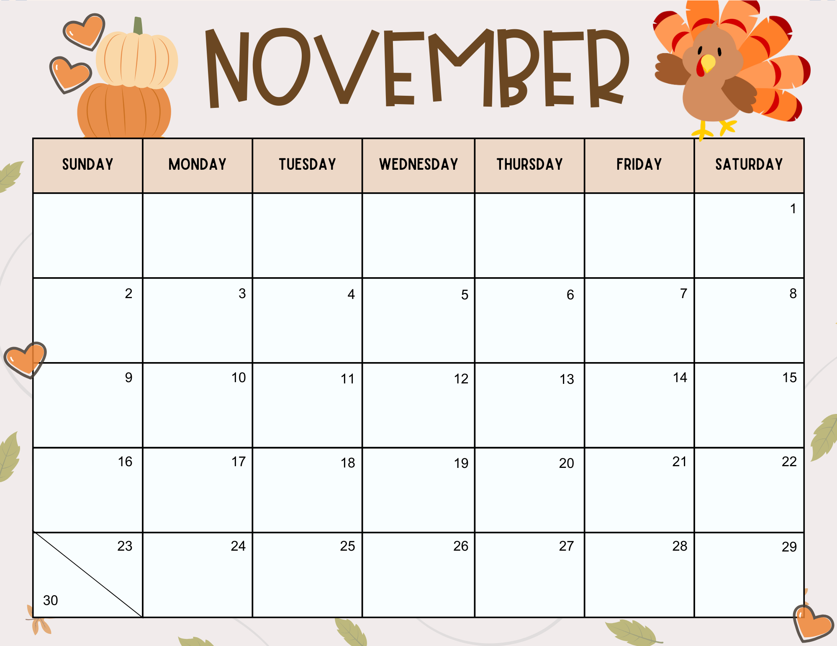
M/W: 6 T/Th: 6 Brown Rectangle
H PreK: E |  |  | PreK Elegant Event | PreK Elegant Event
I PreK: F
J PreK: J |  |  | Friendsgiving WCS Early Release | Friendsgiving

Slide 5
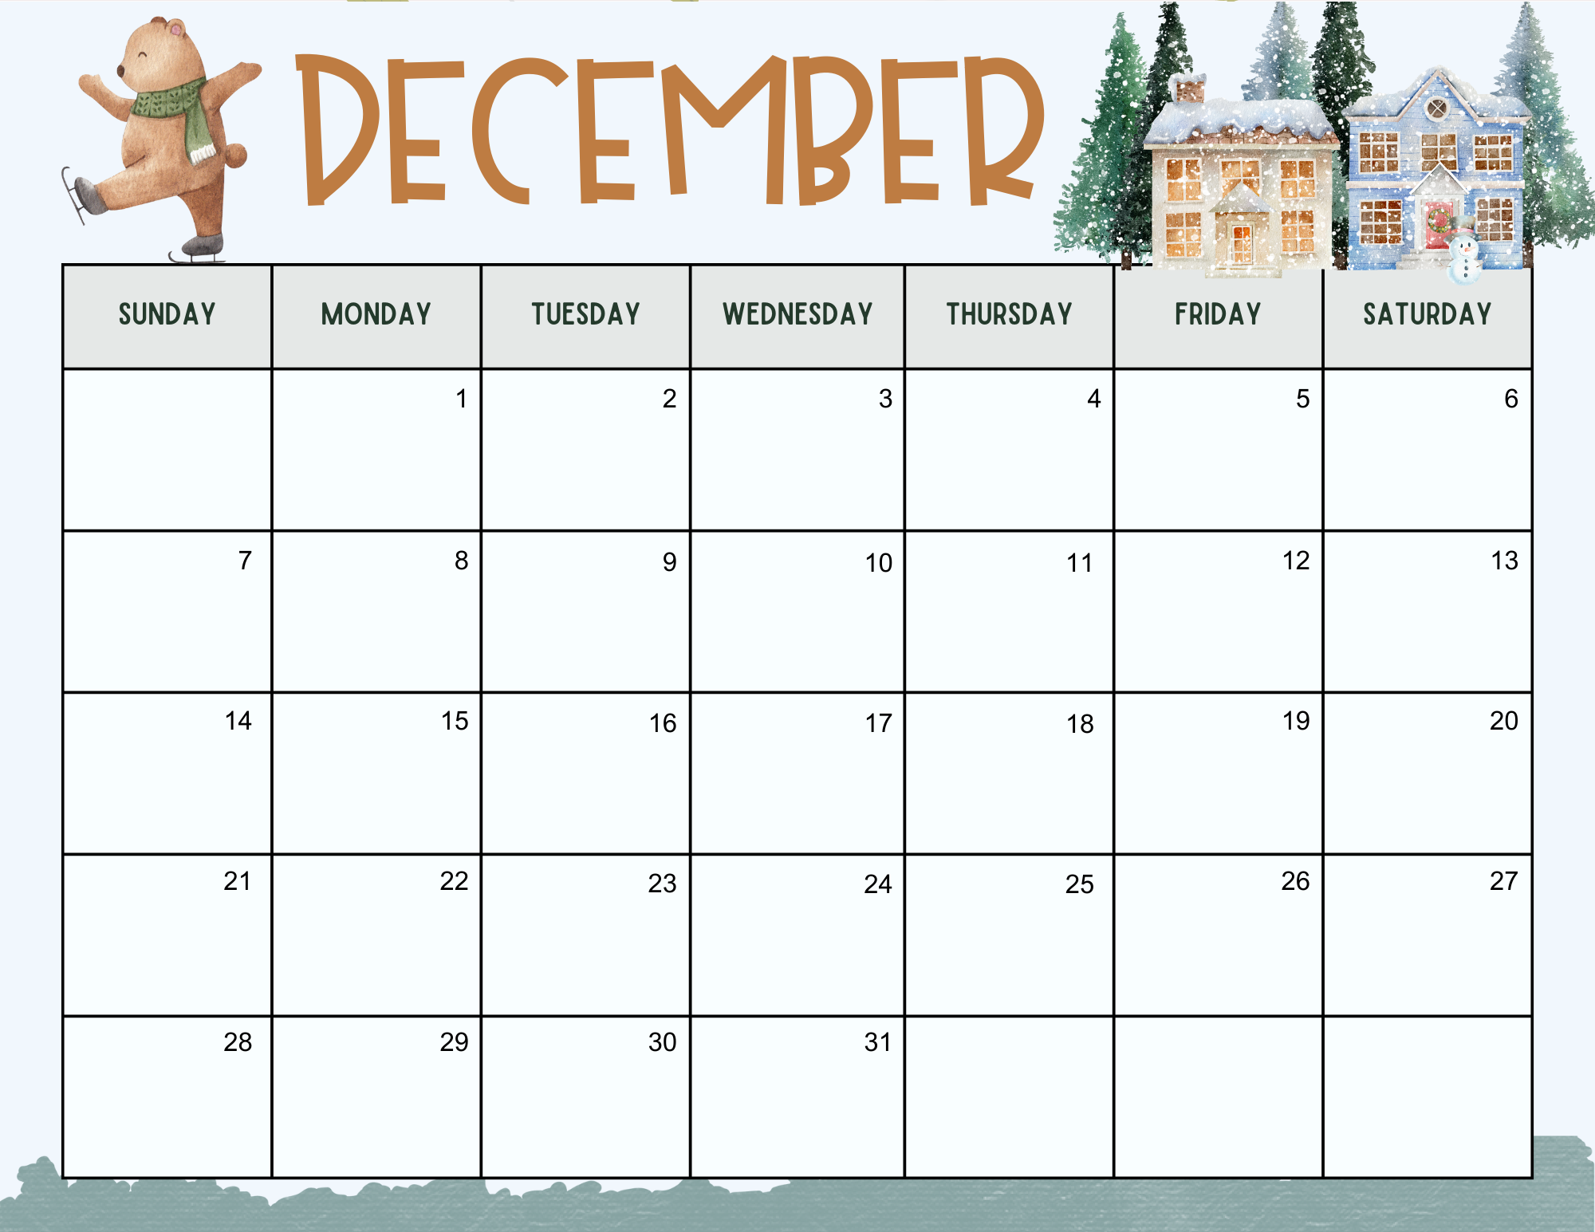
M/W: 4 T/Th: 4 Red Triangle |  |  | Milk & Cookies | Milk & Cookies
 | Program | Program | Last Day | Last Day
 |  | Ms. Tiffany’s Birthday |  | Ms. Kim’s Birthday | Ms. Taylor’s Birthday

Slide 6
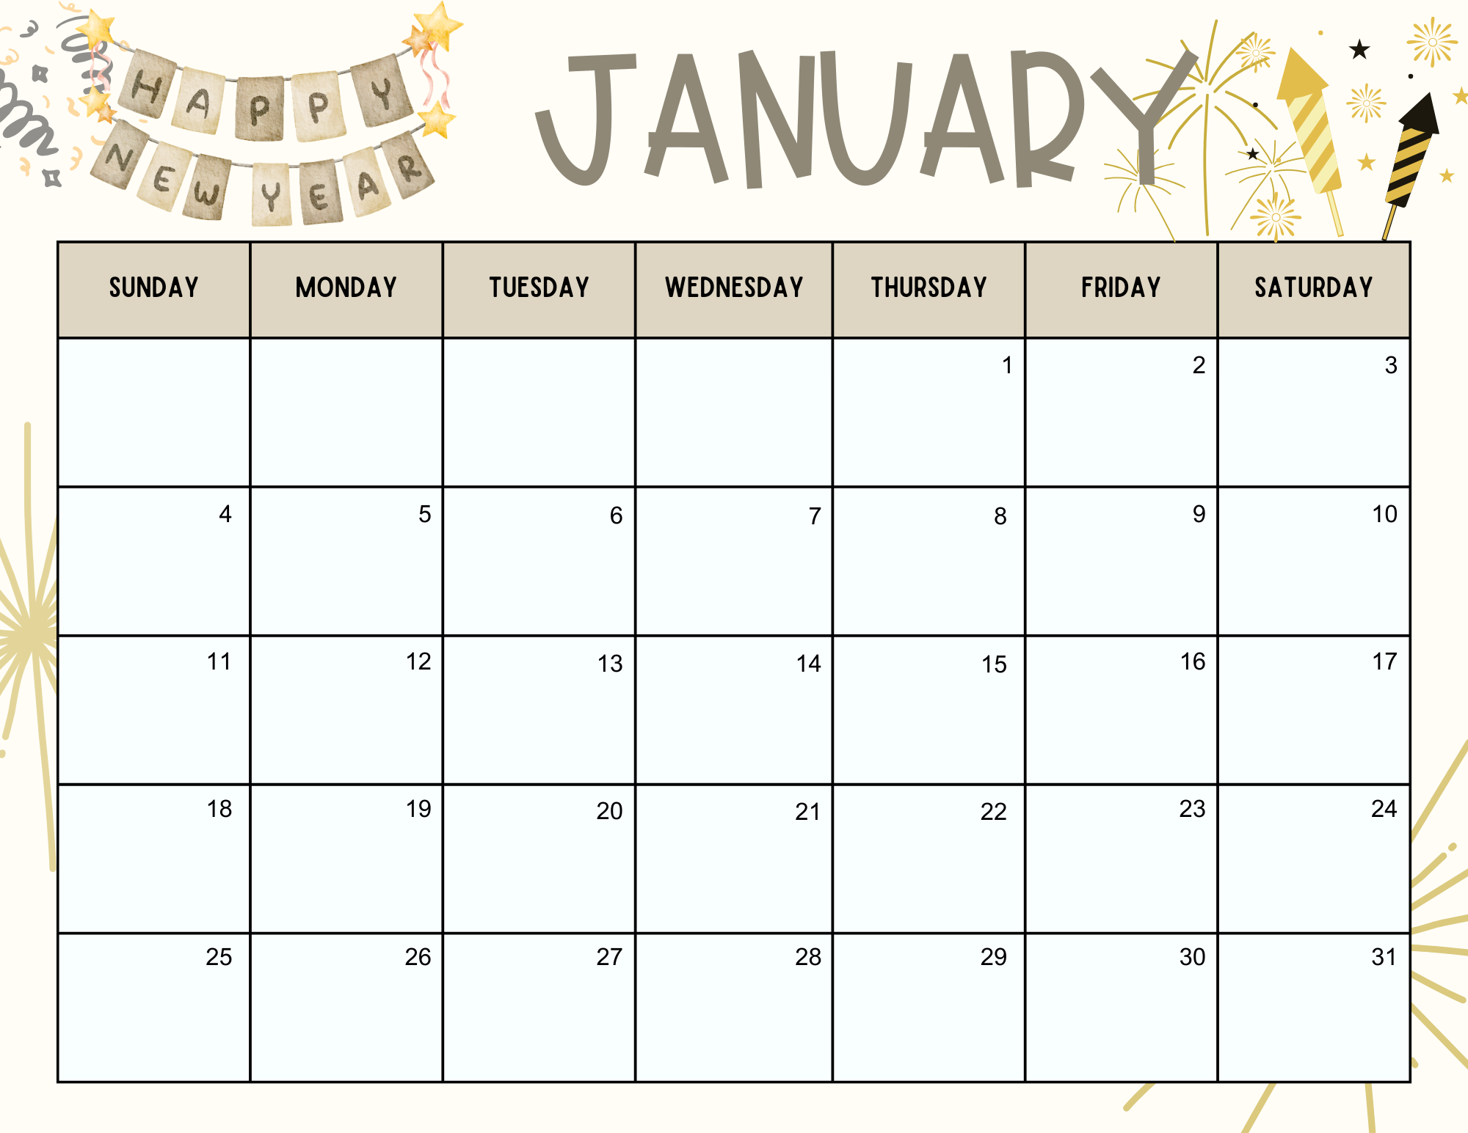
M/W: 7 T/Th: 8 White Oval
K PreK: G | First Day Back
L PreK: H |  |  | WCS Early Release
M PreK: U |  |  |  |  | Ms. Heather’s B’day!
N PreK: B |  |  | WCS Early Release

Slide 7
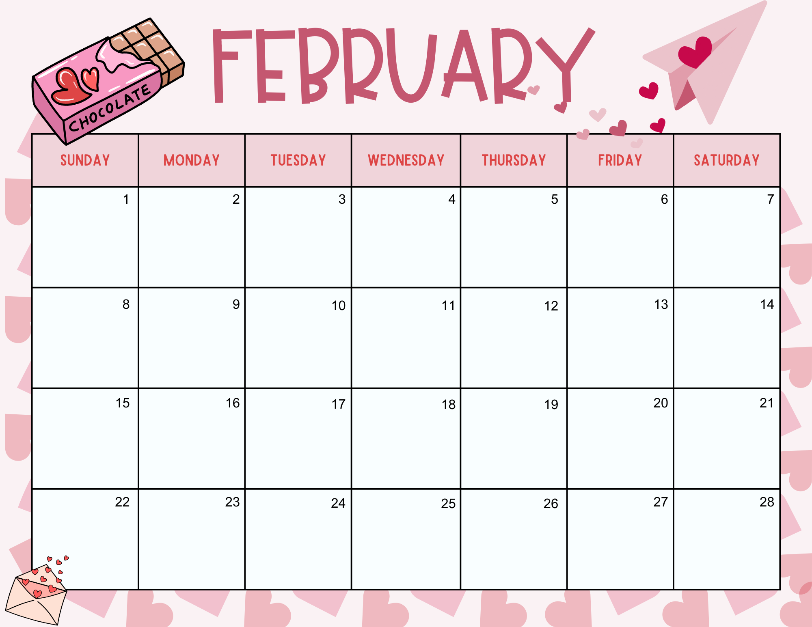
M/W: 7 T/Th: 8 Pink Heart O PreK: M | Hibernation Day | Hibernation Day
PreK: N |  |  | WCS Early Release
P PreK: P |  |  | Pirates and Princesses | Pirates and Princesses
Q PreK: S |  |  |  |  | Ms. Amy’s B’day!

Slide 8
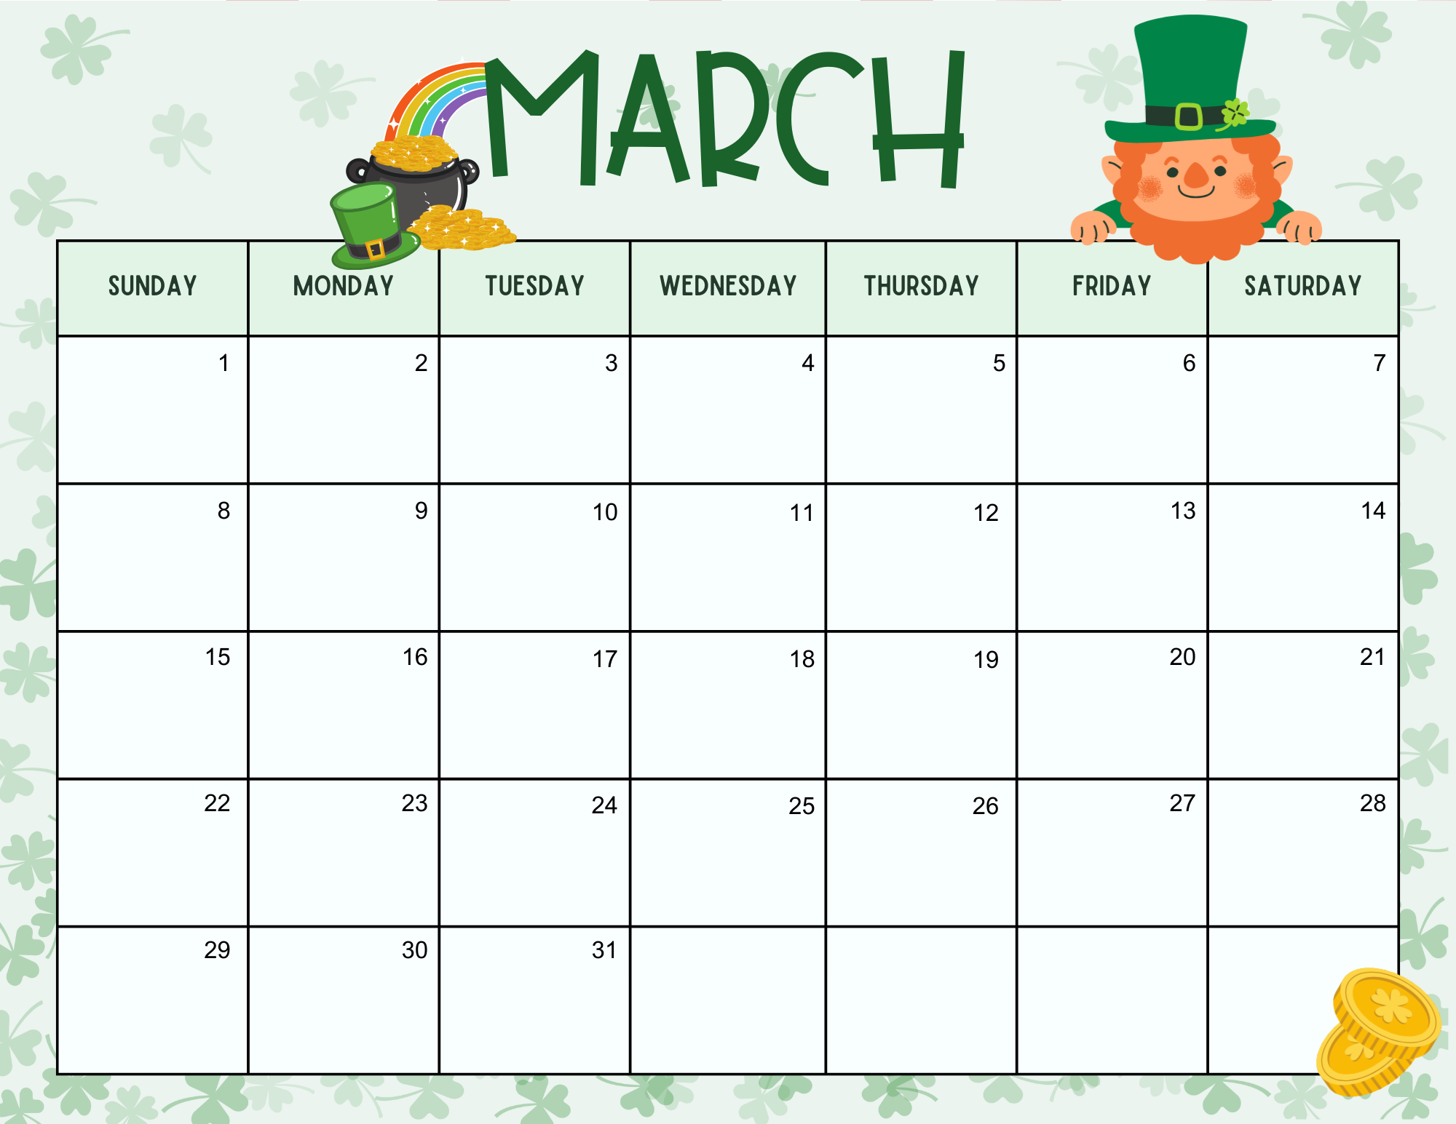
M/W: 7 T/Th: 7 Green Diamond R PreK: R | Read Across America | Read Across America | Read Across America, Rodeo Day Ms. Bethany’s Birthday WCS Early Release | Read Across America, Rodeo Day
S PreK: K | Ms. Ashley’s B’day!
T PreK: Q |  |  | WCS Early Release
 |  | Ms. Kelly Ann’s B’day!

Slide 9
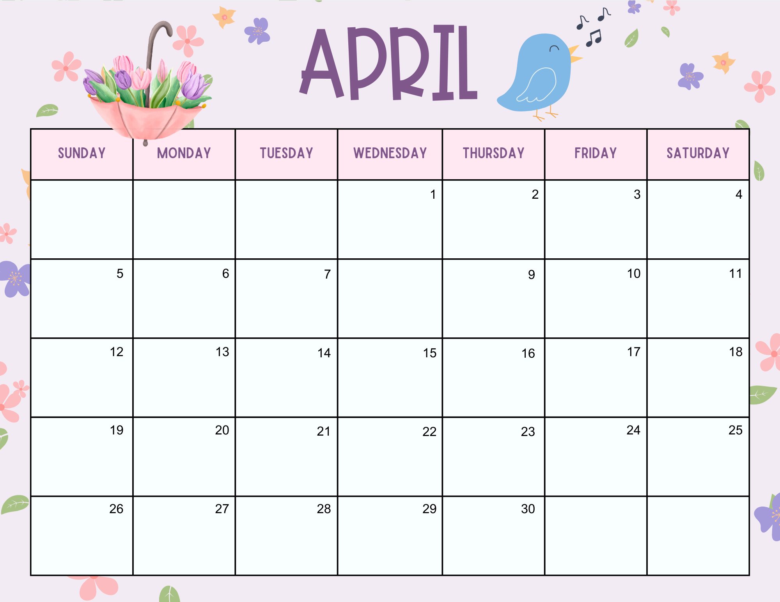
M/W: 9 T/Th: 9 Purple Star
U PreK: U | Egg Hunt | Egg Hunt Ms. Beth’s Birthday | Ms. Marti’s 8 Birthday WCS Early Release | Ms. Blair’s Birthday
V PreK: V
W/X PreK: W/X |  |  | Earth Day Celebration! | Earth Day Celebration!
Y/Z PreK: Y/Z

Slide 10
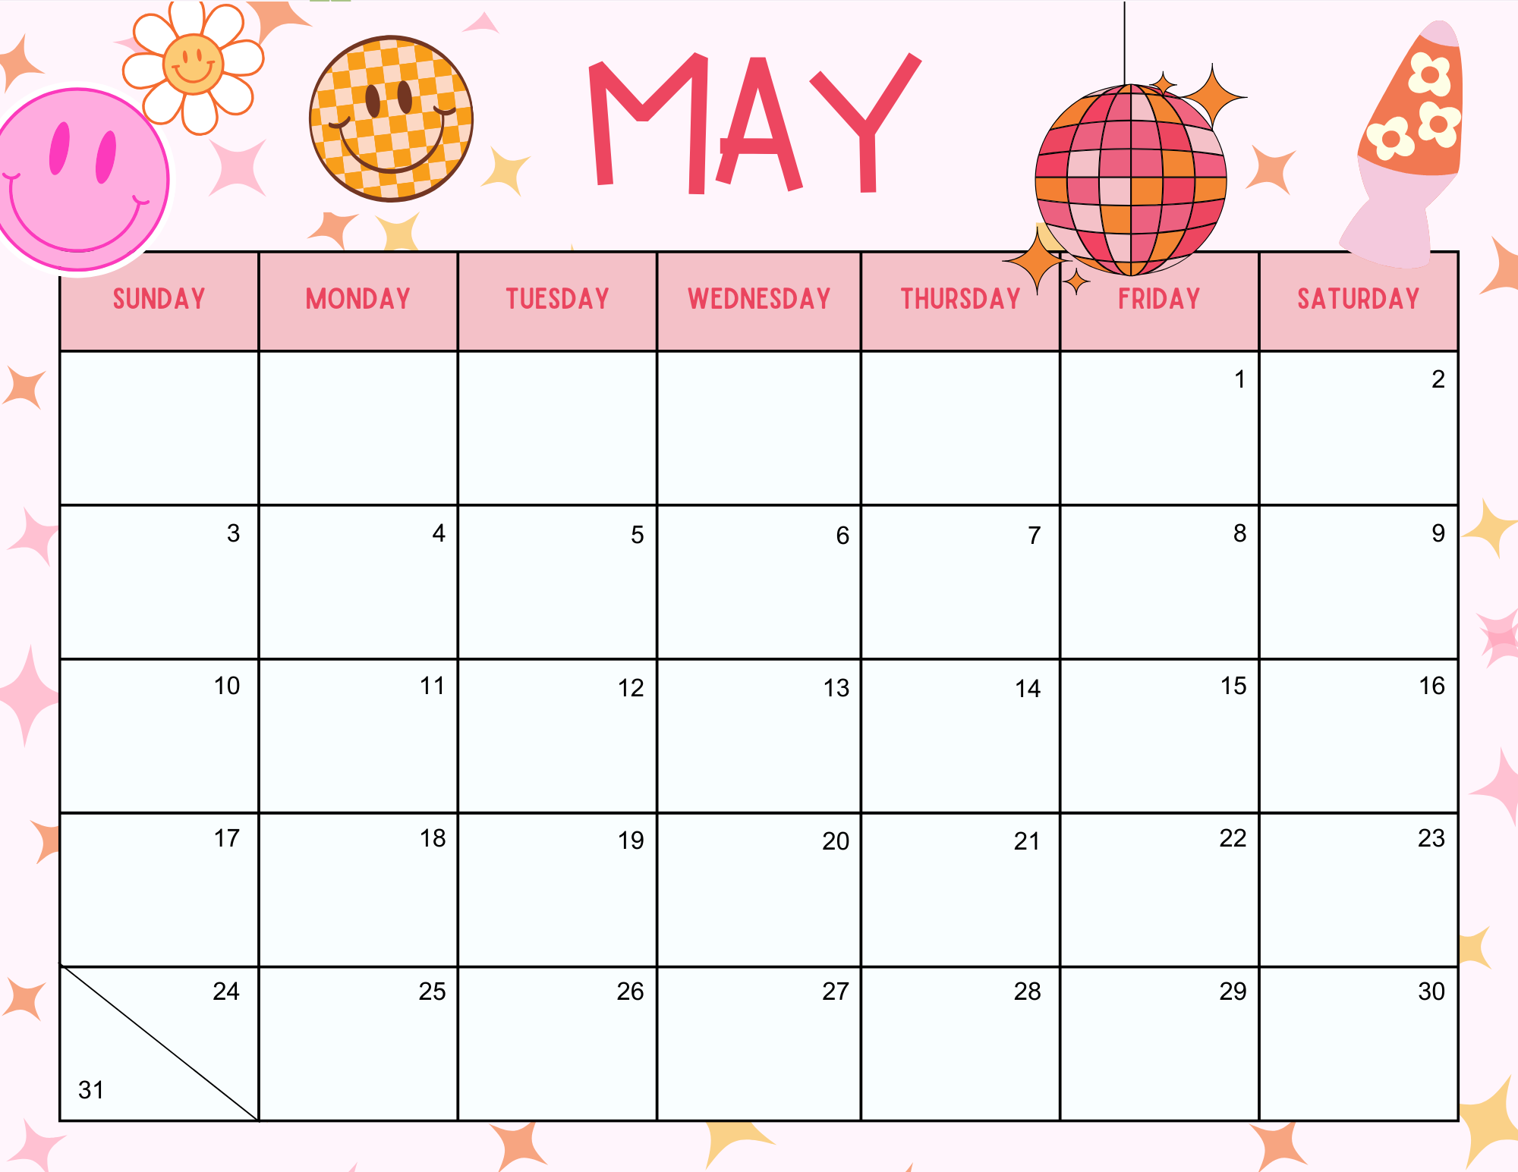
M/W: 4 T/Th: 4 Blue Review Shapes |  |  |  |  |  | Ms. Kenzie’s Birthday
 |  |  | End of Year Program | End of Year Program
 |  |  | Last Day | Last Day |  | Ms. Ashley’s B’day!
 |  |  | Ms. Debbie’s Birthday | M

Slide 11
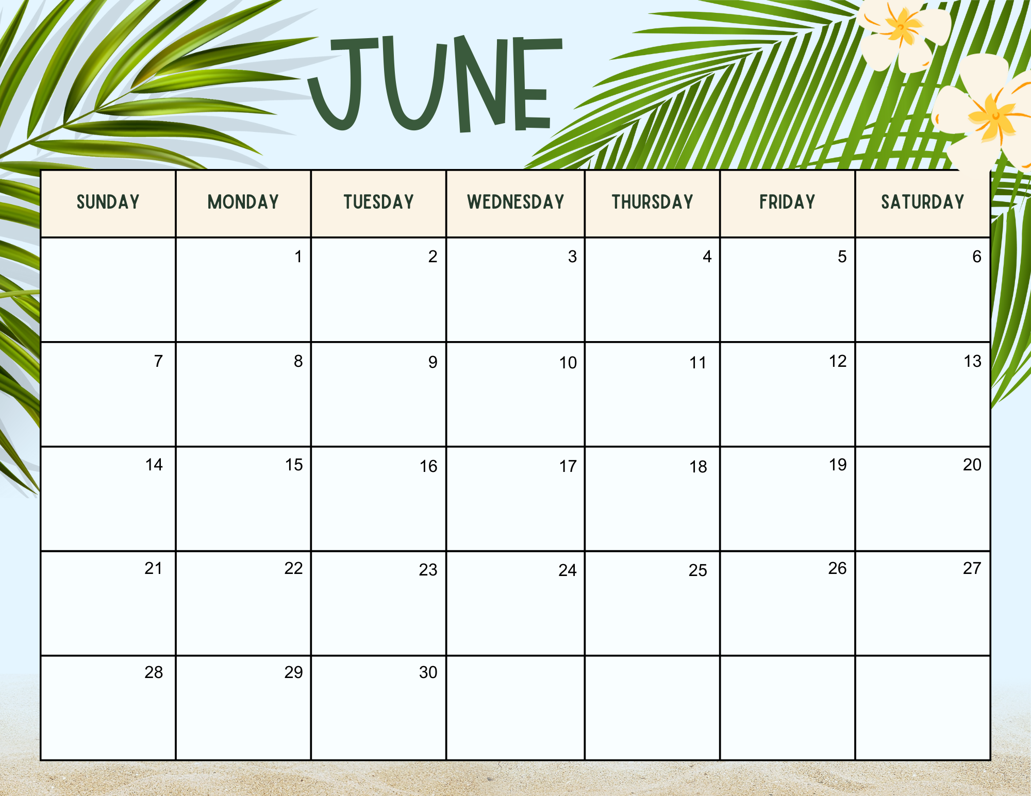
 | Ms. Jiill’s B’day!
 | Ms. Cayci’s B’day!

Slide 12
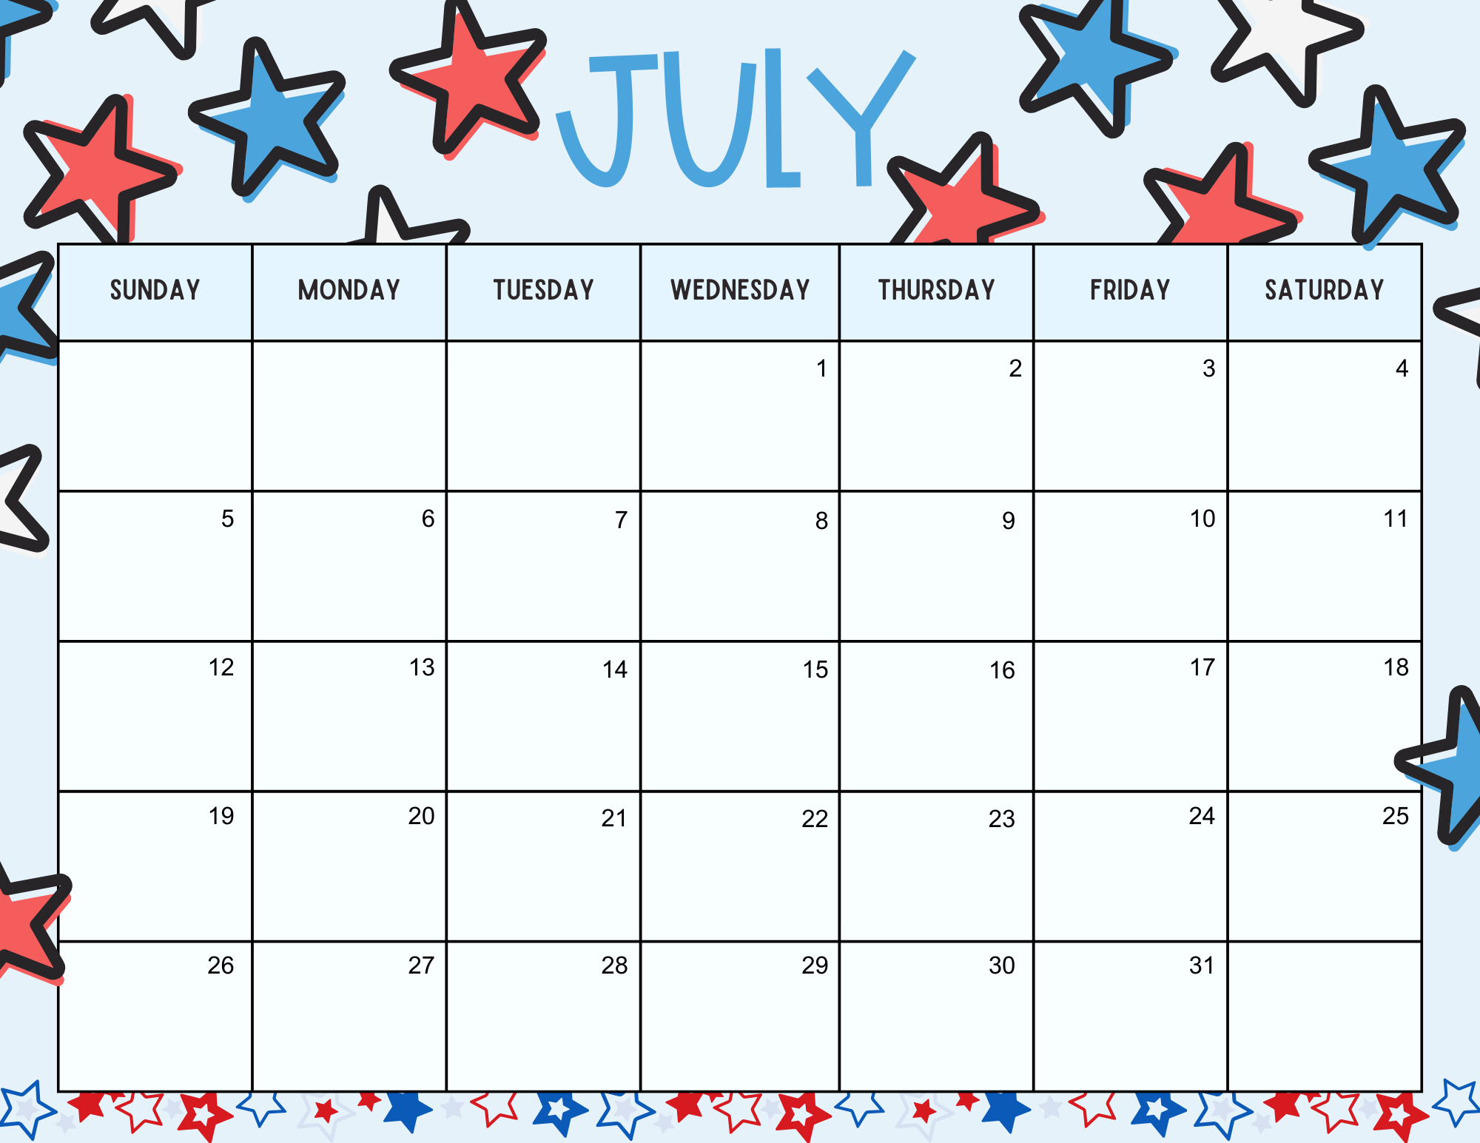
 |  |  |  | Ms. Sandy’s B’day!
 |  |  | Ms. Katie’s B’day! |  |  | Ms. Heather’s B’day!

